Slide 1

Ant Colony Optimization
HUANG JIAHUI（44251017）

Slide 2
Content
n
Background Information
n
Ant Colony Optimization
n
Elitist Ant System (EAS)
n
How ACO is Applied to JSSP
n
EAS Algorithm Steps for JSSP
n
Summary

Slide 3

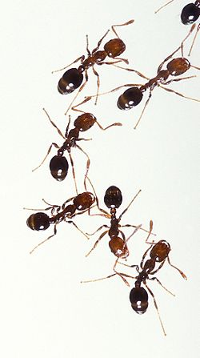
Ant Colony Optimization
n Reference
Flórez E, Gómez W, Bautista L. An ant colony optimization algorithm for job shop scheduling problem[J]. arXiv preprint arXiv:1309.5110, 2013.
M. Dorigo, Optimization, Learning and Natural Algorithms, PhD thesis, Politecnico di Milano, Italy, 1992.
n Background
n
First introduced by Marco Dorigo in 1992
n
Ant Colony Optimization (ACO) is a bio-inspired metaheuristic algorithm modeled on the foraging behavior of real ants.
n
In nature, ants find the shortest path to food by laying down pheromones, which guide other ants toward promising paths through a process of positive feedback.
Marco Dorigo

Slide 4
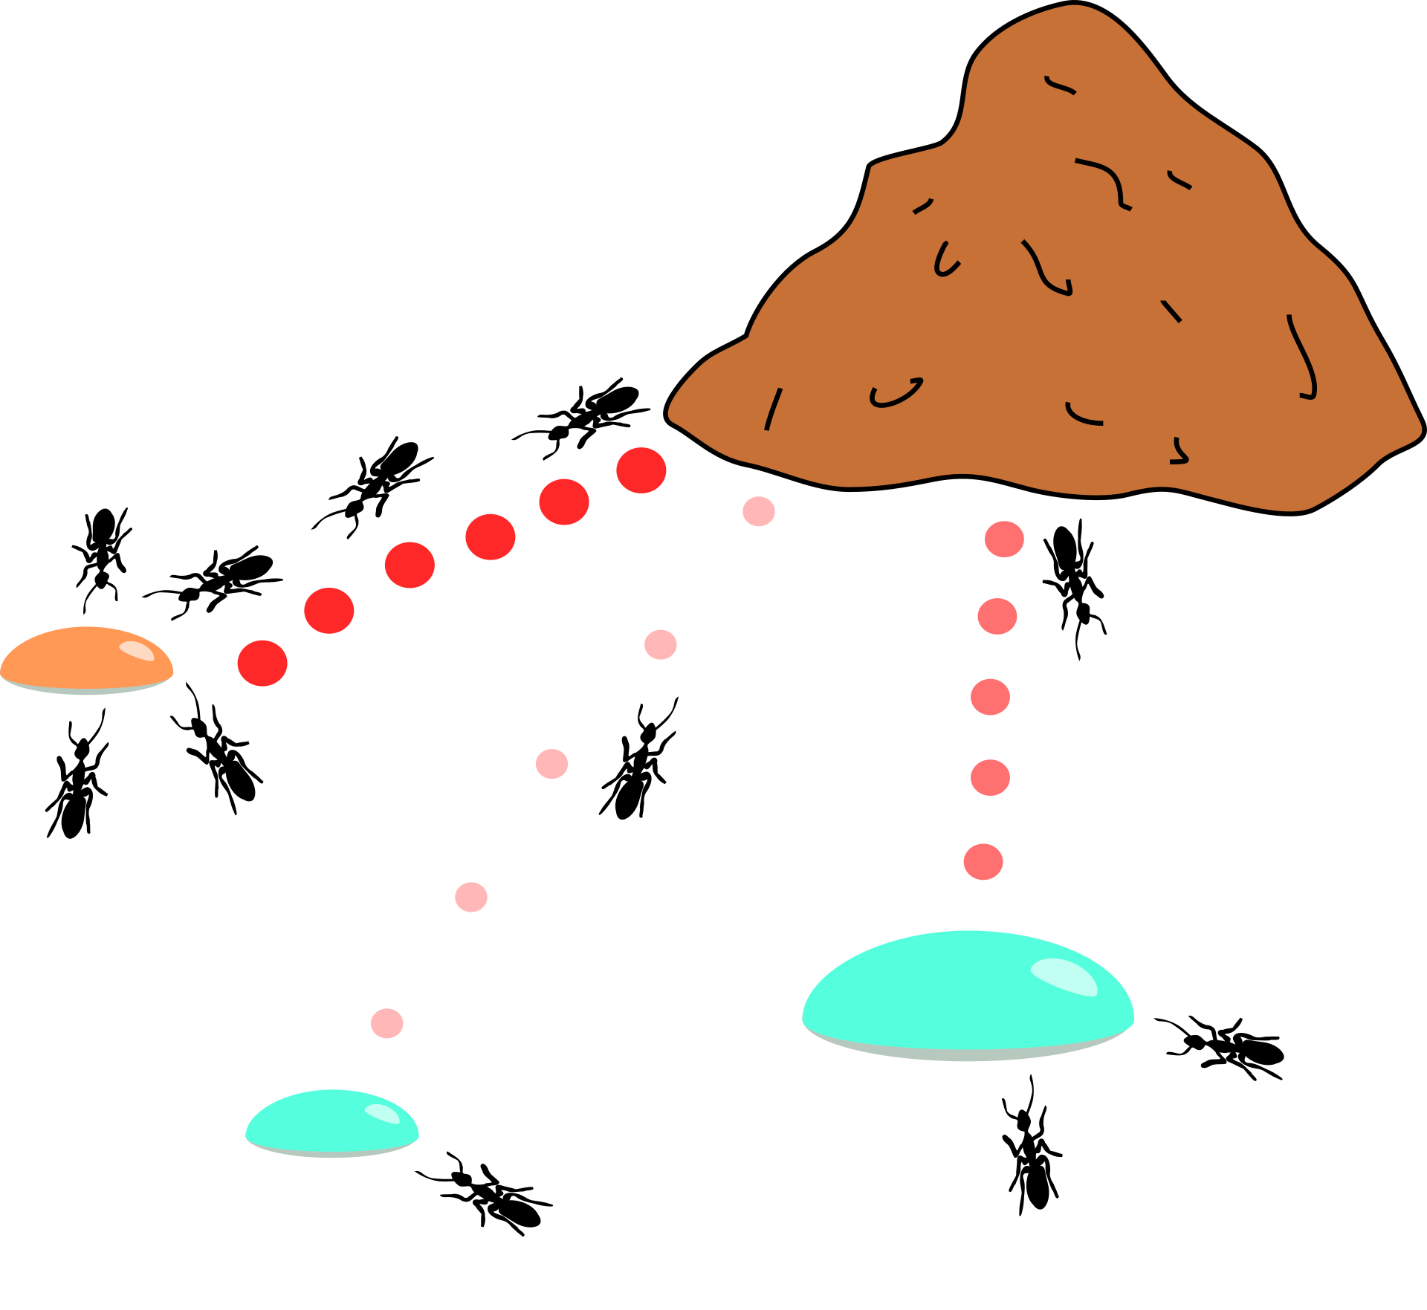
Ant Colony Optimization
n
Real Ant
Limited individual capabilities:
Rudimentary sight
Limited visual and auditory communication
Not capable of achieving complex tasks on there own
Capable of impressive group results:
Nest building and defense
Nest Temperature Regulation
Forming Bridges
Cooperatively carrying large items
Sorting brood and food items
Foraging for food sources

Slide 5
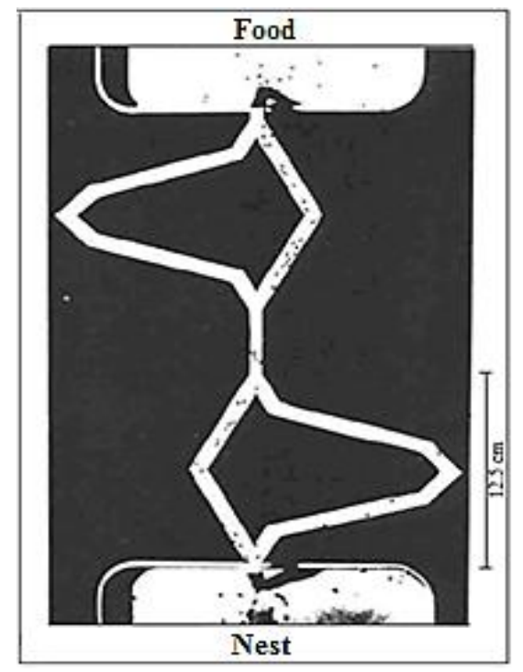
Ant Colony Optimization
n
In scheduling problems, ACO simulates this behavior:
Each feasible solution is represented as a "path" through a graph.
Multiple ants construct solutions in parallel.
Better solutions leave stronger pheromone trails, biasing future searches toward high-quality regions.
The algorithm maintains a balance between exploitation (using known good paths) and exploration (discovering new paths).

Slide 6
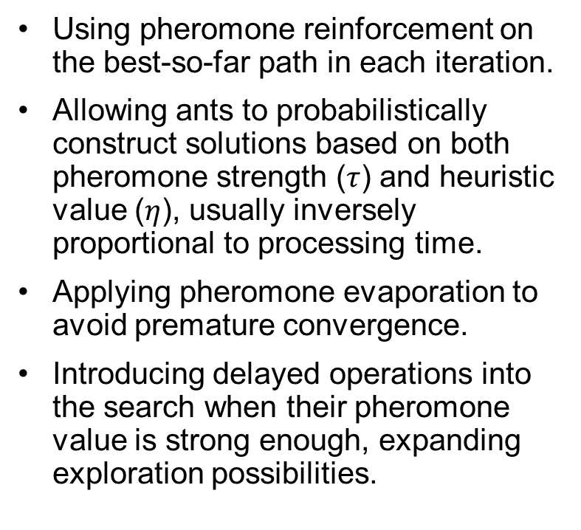
Elitist Ant System (EAS)
n
This paper implements an Ant Colony Optimization (ACO) variant called the Elitist Ant System (EAS), which enhances the basic ACO by:
Using pheromone reinforcement on the best-so-far path in each iteration.
Allowing ants to probabilistically construct solutions based on both pheromone strength ($τ$) and heuristic value ($η$), usually inversely proportional to processing time.
Applying pheromone evaporation to avoid premature convergence.
Introducing delayed operations into the search when their pheromone value is strong enough, expanding exploration possibilities.
The core algorithm steps include:
Initializing pheromones and parameters (α, β, evaporation rate).
Each ant constructs a solution respecting JSSP constraints.
Pheromones are updated globally using the best solution of the iteration (elitist reinforcement).
The process iterates for a fixed number of cycles.

Slide 7
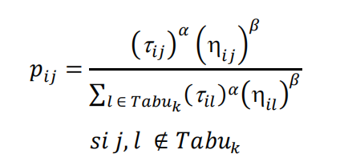
How ACO is Applied to JSSP
n In the Job Shop Scheduling Problem (JSSP), each job consists of a sequence of operations processed on specific machines in a strict order.
Application process:
Graph Representation:
Nodes = operations;
Edges = precedence or machine-based connections.
Solution Construction:
Ants choose operations based on:
Pheromone Updates:
Best ants deposit more pheromone to reinforce good paths.
Evaporation reduces influence of older solutions.

Slide 8
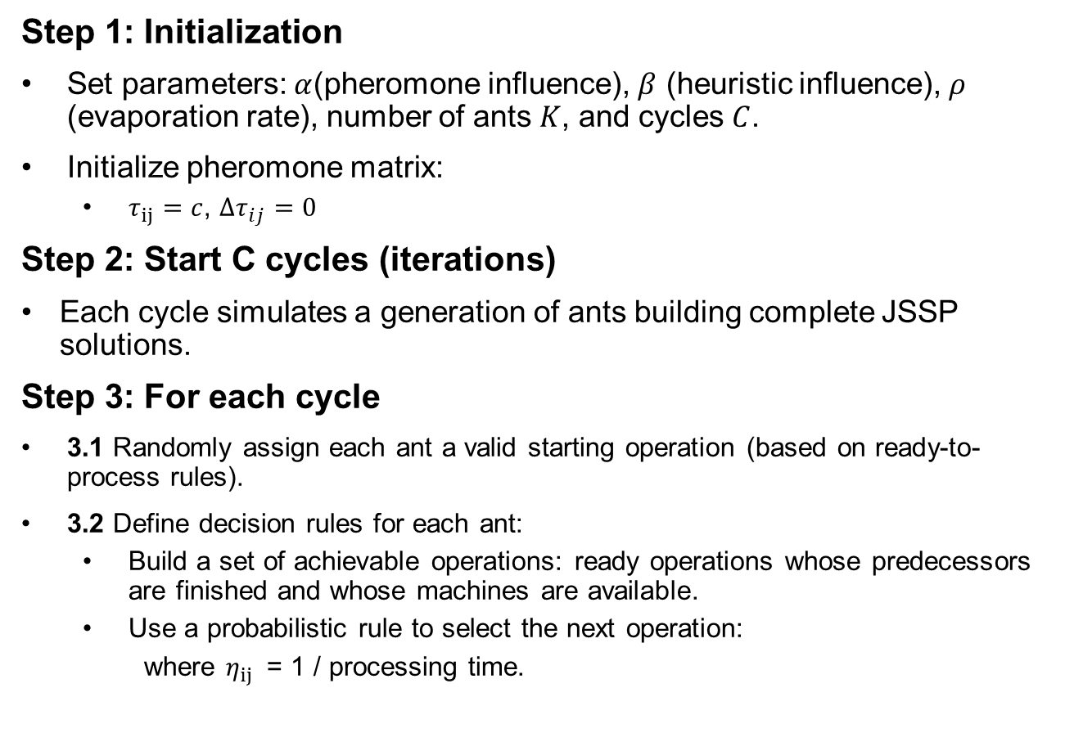
EAS Algorithm Steps for JSSP
Step 1: Initialization
Set parameters: $α$(pheromone influence), $β$ (heuristic influence), $ρ$ (evaporation rate), number of ants $K$, and cycles $C$.
Initialize pheromone matrix:
$τ_{ij}=c$, $∆τ_{ij}=0$
Step 2: Start C cycles (iterations)
Each cycle simulates a generation of ants building complete JSSP solutions.
Step 3: For each cycle
3.1 Randomly assign each ant a valid starting operation (based on ready-to-process rules).
3.2 Define decision rules for each ant:
Build a set of achievable operations: ready operations whose predecessors are finished and whose machines are available.
Use a probabilistic rule to select the next operation:
where $η_{ij}$​ = 1 / processing time.

Slide 9
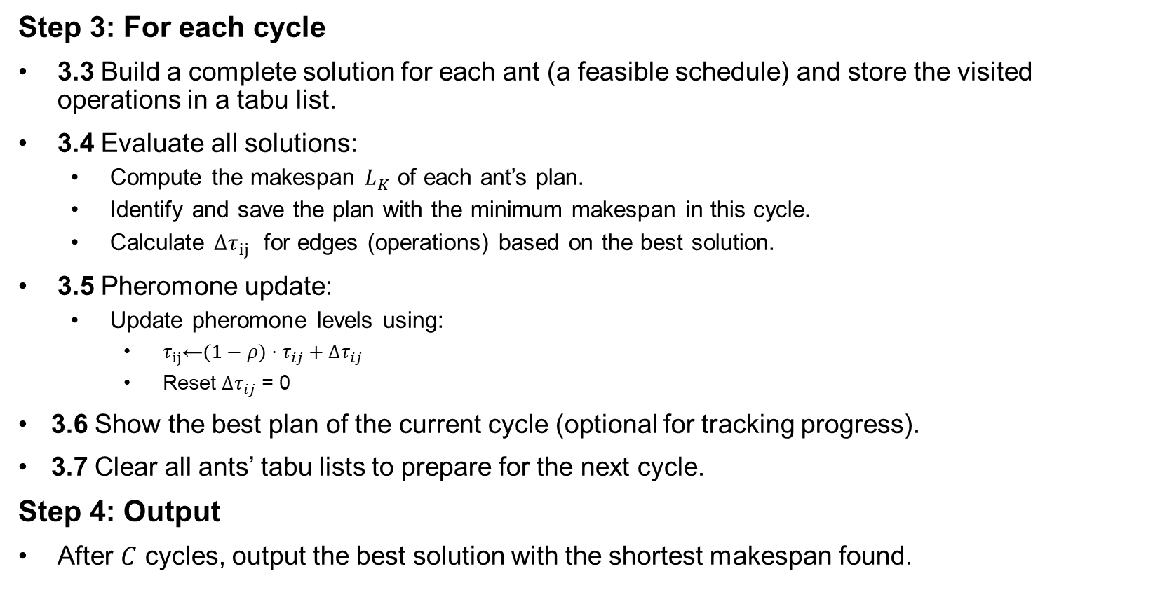
EAS Algorithm Steps for JSSP
Step 3: For each cycle
3.3 Build a complete solution for each ant (a feasible schedule) and store the visited operations in a tabu list.
3.4 Evaluate all solutions:
Compute the makespan $L_{K}$ of each ant’s plan.
Identify and save the plan with the minimum makespan in this cycle.
Calculate $Δτ_{ij}$ for edges (operations) based on the best solution.
3.5 Pheromone update:
Update pheromone levels using:
$τ_{ij}$​←$(1−ρ)⋅τ_{ij​}+Δτ_{ij​}​$
Reset $Δτ_{ij​}​$ ​= 0
3.6 Show the best plan of the current cycle (optional for tracking progress).
3.7 Clear all ants’ tabu lists to prepare for the next cycle.
Step 4: Output
After $C$ cycles, output the best solution with the shortest makespan found.

Slide 10
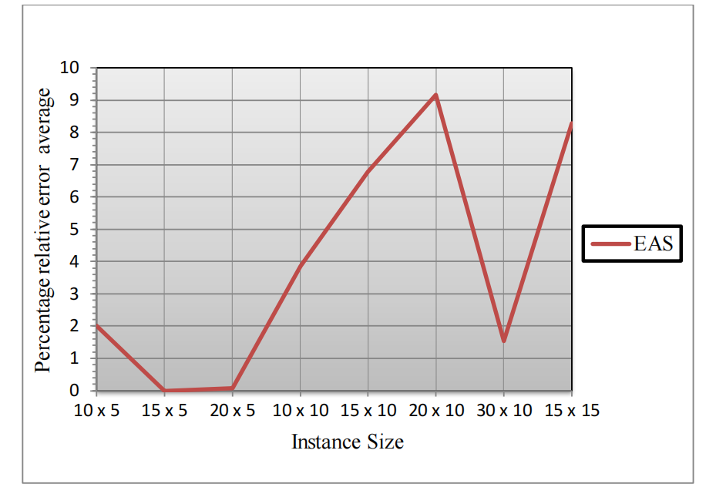
Experimental Results
The algorithm's performance was evaluated using 40 standard benchmark instances known as Lawrence instances (e.g., LA01, LA02).
Solution Quality: The algorithm successfully found the Best Known Solution (BKS) in 27.5% of the instances, particularly those with smaller dimensions (e.g., 10x5, 15x5). Across all 40 instances, the average relative error compared to the BKS was a low 4%. About 65% of the solutions were within 5% of the BKS.
Computational Efficiency: The most remarkable result was the algorithm's high efficiency. It required a significantly lower number of objective function evaluations to find solutions compared to other methods. For instance, the proposed EAS averaged 3,307 evaluations, whereas other algorithms like Tabu Search (TS), Artificial Immune System (AIS), and Cultural Algorithm (CULT) required 11,108, 175,058, and 454,525 evaluations, respectively.
Stability: The algorithm demonstrated stability, as indicated by a low standard deviation in its results across multiple runs.
Relative Error average by instance size

Slide 11
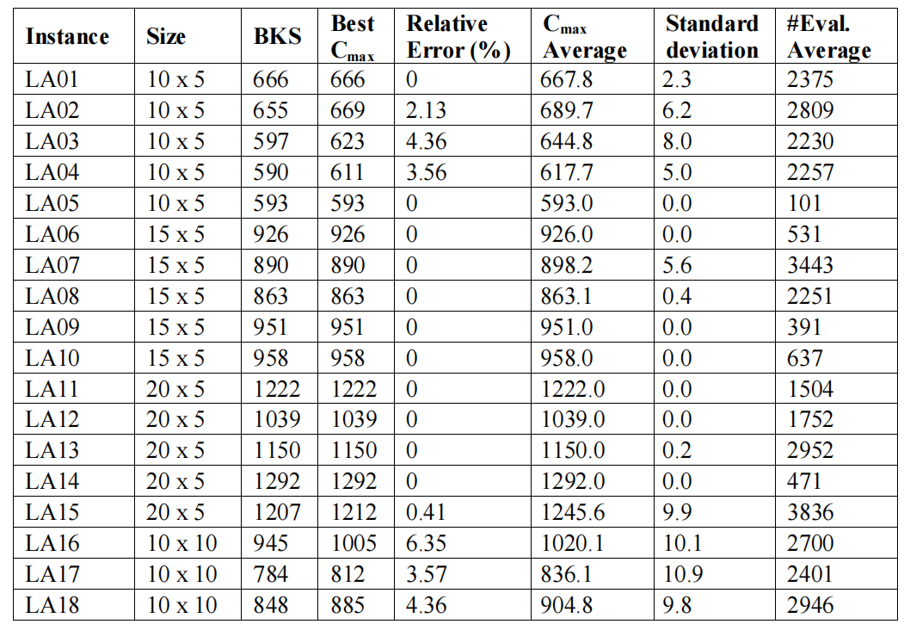
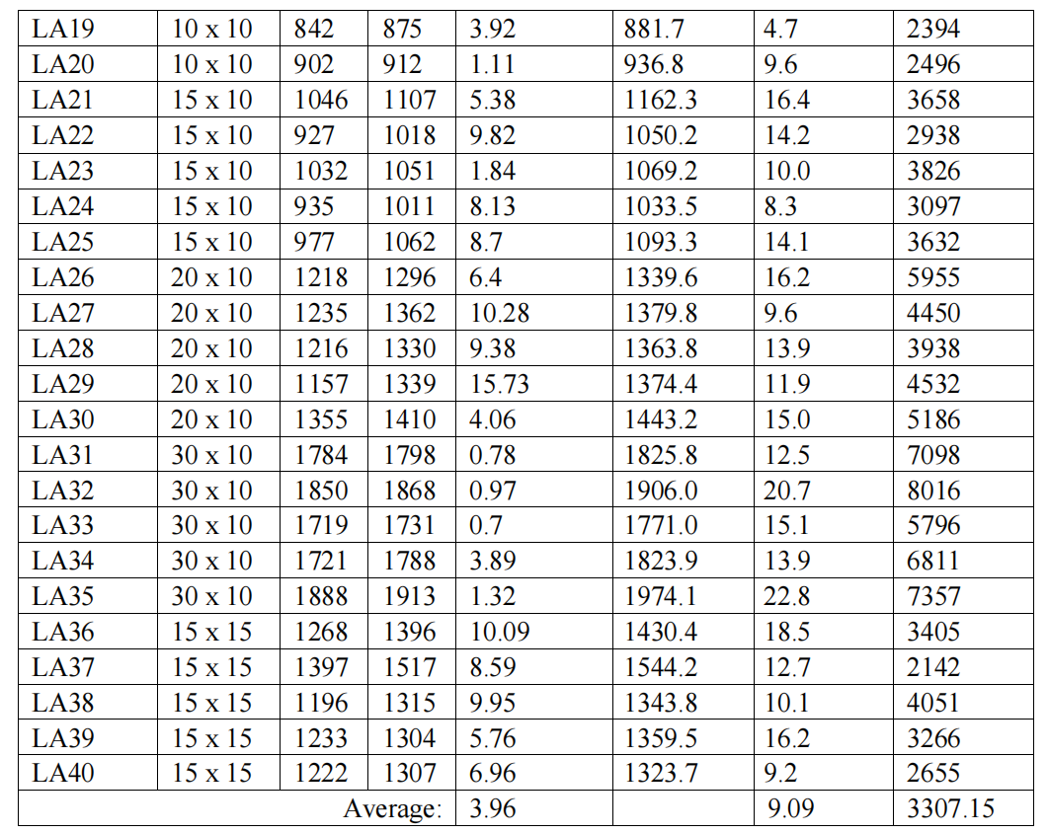
Experimental Results
Experimental results

Slide 12
Summary
The primary strength of the presented EAS algorithm is its exceptional computational efficiency. In optimization, especially for NP-hard problems like JSSP, finding a high-quality solution quickly is often more practical than finding the absolute optimal solution after an impractically long time. This algorithm excels at providing "economic" solutions with minimal time and resource investment.
There is a clear trade-off between solution quality and speed. While the 4% average error is good, the algorithm failed to find the BKS in over 70% of cases. Its performance notably decreased on more complex problems with more machines. This suggests that while it's excellent for rapid approximation, it may not be suitable for scenarios where achieving the certified optimum is the main goal.
Overall, the algorithm is a strong candidate for real-world scheduling applications where quick and reliable planning is needed. For future improvements, it could be hybridized with a local search method. The ACO could be used to quickly find promising regions of the search space, and then a local search could fine-tune the solutions in that region to improve their final quality without adding a massive computational burden.

Slide 13
Thank You

